Slide 1


Slide 2
CHAPTER 28
Data Mining Concepts
Slide 28- 2

Slide 3
Chapter Outline
1 Data Mining
  1.1. Data Mining vs. Data Warehousing
  1.2 Knowledge Discovery in Databases (KDD)
  1.3 Goals of Data Mining and Knowledge Discovery
  1.4 Types of Knowledge Discovered
2 Association Rules
  2.1 Association Rules Confidence and Support
  2.2 Apriori Algorithm
Slide 28- <number>

Slide 4
Chapter Outline
3 Classification
4 Clustering
5 Other Data Mining Algorithms
  5.1 Sequential pattern discovery
  5.2 Time Series Analysis
  5.3 Regression
  5.4 Neural Networks
  5.5 Genetic Algorithms
6 Data Mining Applications
7 Commercial Data Mining Tools
Slide 28- <number>

Slide 5
1 Definitions of Data Mining
The discovery of new information in terms of patterns or rules from vast amounts of data.
The process of finding interesting structure in data.
The process of employing one or more computer learning techniques to automatically analyze and extract knowledge from data.
Slide 28- <number>

Slide 6
1.1 Data Mining vs. Data Warehousing
The data warehouse is a historical database designed for decision support.
Data mining can be applied to the data in a warehouse to help with certain types of decisions.
Proper construction of a data warehouse is fundamental to the successful use of data mining.
Most enterprises (Fortune 500 companies) already have data warehouses. They are now trying very hard to benefit from that data with mining techniques.
Slide 28- <number>

Slide 7
1.2 Knowledge Discovery in Databases (KDD)
Data mining is actually one step of a larger process known as knowledge discovery in databases (KDD).
The KDD process model comprises six phases
  Data selection
  Data cleansing
  Enrichment
  Data transformation or encoding
  Data mining
  Reporting and displaying discovered knowledge
Slide 28- <number>

Slide 8
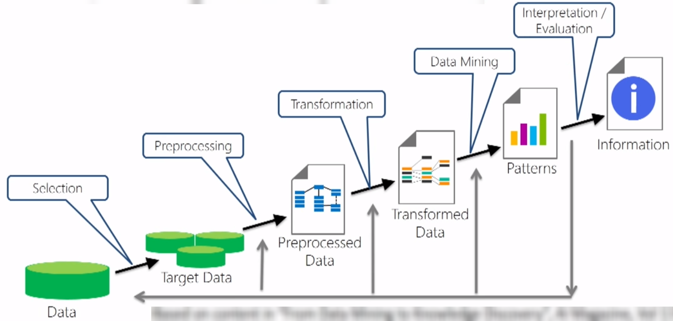
Knowledge Discovery in Databases (KDD) Steps
Img source: https://www.pinterest.ca/pin/672232681855858885/
Slide 28- <number>

Slide 9
1.3 Goals of Data Mining and Knowledge Discovery (PICO)
Prediction:
  Determine how certain attributes will behave in the future.
Identification:
  Identify the existence of an item, event, or activity.
Classification:
  Partition data into classes or categories.
Optimization:
  Optimize the use of limited resources.
Slide 28- <number>

Slide 10
1.4 Types of Discovered Knowledge
Association Rules
Classification Hierarchies
Sequential Patterns
Patterns Within Time Series
Clustering
Slide 28- <number>

Slide 11
2 Association Rules
Association rules are frequently used to generate rules from market-basket data.
  A market basket corresponds to the sets of items a consumer purchases during one visit to a supermarket.
The set of items purchased by customers is known as an itemset. For example, {bread, milk, cheese}
An association rule is of the form X=>Y, where X ={x₁, x₂, …., x_{n} }, and Y = {y₁,y₂, …., y_{n}} are sets of items, with x_{i} and y_{i} being distinct items for all i and all j.
  For an association rule to be of interest, it must satisfy a minimum support and confidence.
Slide 28- <number>

Slide 12
2.1 Association Rules Confidence and Support
Support:
  The minimum percentage of instances in the database that contain all items listed in a given association rule.
  Support is the percentage of transactions that contain all of the items in the itemset, LHS U RHS.
Confidence:
  Given a rule of the form A=>B, rule confidence is the conditional probability that B is true when A is known to be true.
  Confidence can be computed as
    support(LHS U RHS) / support(LHS)
Slide 28- <number>

Slide 13
2.2 Generating Association Rules and Apriori Algorithm
The general algorithm for generating association rules is a two-step process.
  Generate all itemsets that have a support exceeding the given threshold. Itemsets with this property are called large or frequent itemsets.
  Generate rules for each itemset as follows:
    For itemset X and Y a subset of X, let Z = X – Y;
    If support(X)/Support(Z) > minimum confidence, the rule Z=>Y is a valid rule.
Slide 28- <number>

Slide 14
Reducing Association Rule Complexity
Two properties are used to reduce the search space for association rule generation.
  Downward Closure
    A subset of a large itemset must also be large
  Anti-monotonicity
    A superset of a small itemset is also small. This implies that the itemset does not have sufficient support to be considered for rule generation.
Slide 28- <number>

Slide 15
The Apriori Algorithm (1)
The Apriori algorithm was the first algorithm used to generate association rules.
  The Apriori algorithm uses the general algorithm for creating association rules together with downward closure and anti-monotonicity.
Slide 28- <number>

Slide 16
The Apriori Algorithm (2)
Algorithm 28.1. Apriori Algorithm for Finding Frequent (Large) Itemsets
Input: Database of m transactions, D, and a minimum support, mins, represented as a fraction of m.
Output: Frequent itemsets, L₁, L₂, ..., L_{k}
Begin /* steps or statements are numbered for better readability */
1. Compute support(i_{j}) = count(i_{j})/m for each individual item, i₁, i₂, ..., i_{n} by scanning the database once and counting the number of transactions that item i_{j} appears in (that is, count(i_{j}));
Slide 28- <number>

Slide 17
The Apriori Algorithm (3)
2. The candidate frequent 1-itemset, C₁, will be the set of items i₁, i₂, ..., i_{n};
3. The subset of items containing i_{j} from C₁ where support(i_{j}) >= mins becomes the frequent 1-itemset, L₁;
4. k = 1;
termination = false;
repeat
…..
until termination (for this part see the next slide)
Slide 28- <number>

Slide 18
The Apriori Algorithm (4)
repeat
1. L_{k+1} = (empty set) ;
2. Create the candidate frequent (k+1)-itemset, C_{k+1}, by combining members of L_{k} that have k–1 items in common (this forms candidate frequent (k+1)-itemsets by selectively extending frequent k-itemsets by one item);
3. In addition, only consider as elements of C_{k+1} those k+1 items such that every subset of size k appears in L_{k};
4. Scan the database once and compute the support for each member of C_{k+1}; if the support for a member of C_{k+1} >= mins then add that member to L_{k+1};
5. If L_{k+1} is empty then termination = true
else k = k + 1;
until termination;
End;
Slide 28- <number>

Slide 19
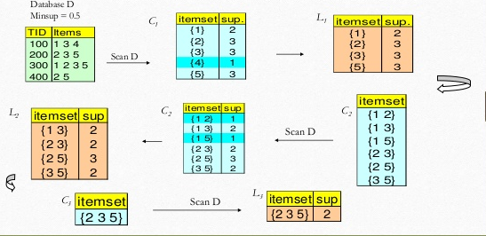
The Apriori Algorithm (Example)
Input= Transaction Database, min sup= 0.5
Output: Set of all frequent itemsets
Set of all frequent itemsets = L1 U L2 U L3 = {(1},{2},{3},{5},{1,3},{2,3},{2,5},{3,5},{2,3,5}}
Slide 28- <number>

Slide 20
3. Classification
Classification is the process of learning a model that is able to describe different classes of data.
Learning is supervised as the classes to be learned are predetermined.
Learning is accomplished by using a training set of pre-classified data.
The model produced is usually in the form of a decision tree or a set of rules.
Slide 28- <number>

Slide 21
Decision Tree Construction (1)
Algorithm 28.3. Algorithm for Decision Tree Induction
Input: Set of training data records: R₁, R₂, ..., R_{m} and set of attributes: A₁, A₂, ..., A_{n}
Output: Decision tree
procedure Build_tree (records, attributes);
Begin
create a node N;
if all records belong to the same class, C then
return N as a leaf node with class label C;
if attributes is empty then return N as a leaf node with class label C, such that the majority of records belong to it;
select attribute A_{i} (with the highest information gain) from attributes;
label node N with A_{i};
Slide 28- <number>

Slide 22
Decision Tree Construction (2)
for each known value, v_{j}, of A_{i} do
begin
add a branch from node N for the condition A_{i} = v_{j};
S_{j} = subset of records where A_{i} = v_{j};
if S_{j} is empty then
add a leaf, L, with class label C, such that the majority
of records belong to it and return L
else add the node returned by Build_tree(S_{j},
attributes – A_{i});
end;
End;
Slide 28- <number>

Slide 23
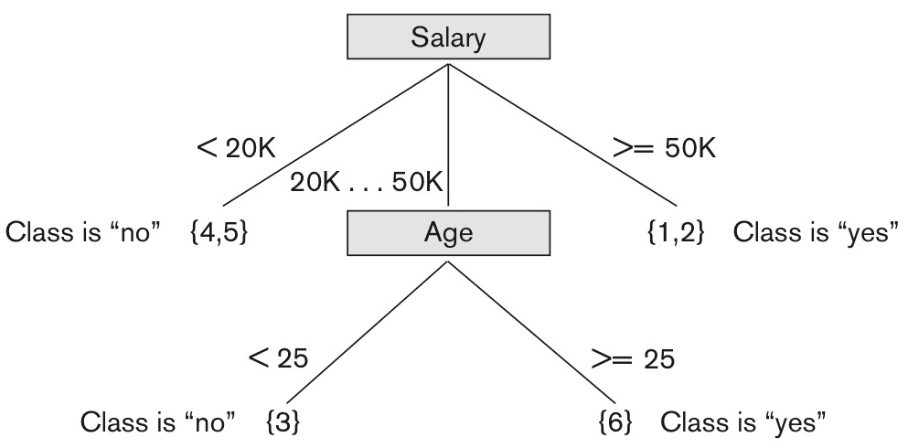
Figure 28.7 Decision tree based on sample training data
Figure 28.7 Decision tree based on sample training data where the leaf nodes are represented by a set of RIDs of the partitioned records.
Slide 28- <number>

Slide 24
An Example Rule
Here is one of the rules extracted from the decision tree of Figure 28.7.
  IF 50K > salary >= 20K
  AND age >=25
  THEN class is “yes”
Another rule
  IF 50K > salary >= 20K
  AND age < 25
  THEN class is “no”
For example: Test Attribute: (Salary,age)= (20K,25), what will be the class?
Slide 28- <number>

Slide 25
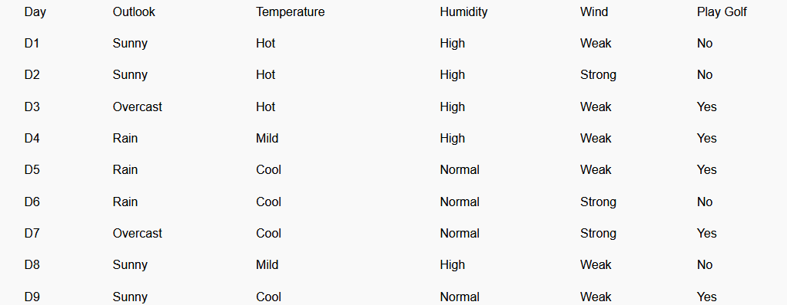
Decision Tree Example Using ID3 Algorithm
Problem: Given the above Data set. Create a decision Tree using ID3 Algorithm.
Solution: Refer to resource file uploaded on Blackboard for complete steps
Slide 28- <number>

Slide 26
4 Clustering
Unsupervised learning or clustering builds models from data without predefined classes.
The goal is to place records into groups where the records in a group are highly similar to each other and dissimilar to records in other groups.
The k-Means algorithm is a simple yet effective clustering technique.
Slide 28- <number>

Slide 27
K-Means Clustering
Algorithm 28.4. k-Means Clustering Algorithm
Input: a database D, of m records, r₁, ..., r_{m} and a desired number of clusters k
Output: set of k clusters that minimizes the squared error criterion
Begin
randomly choose k records as the centroids for the k clusters;
repeat
assign each record, r_{i}, to a cluster such that the distance between r_{i}
and the cluster centroid (mean) is the smallest among the k
clusters;
recalculate the centroid (mean) for each cluster based on the records
assigned to the cluster;
until no change;
End;
Slide 28- <number>

Slide 28
K-Means Clustering Example
Clusters the data into k groups where k is predefined.
Select k points at random as cluster centers.
Assign objects to their closest cluster center according to the Euclidean distance function.
Calculate the centroid or mean of all objects in each cluster.
Repeat steps 2, 3 and 4 until the same points are assigned to each cluster in consecutive rounds.
Slide 28- <number>

Slide 29
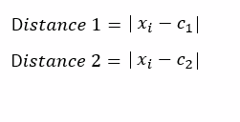
K-Means Clustering Example (Contd..)
Suppose we want to group the visitors to a website using just their age (one-dimensional space) as follows:
n = 19
15,15,16,19,19,20,20,21,22,28,35,40,41,42,43,44,60,61,65
Initial clusters (random centroid or average):
k = 2
c1 = 16
c2 = 22
Slide 28- <number>

Slide 30
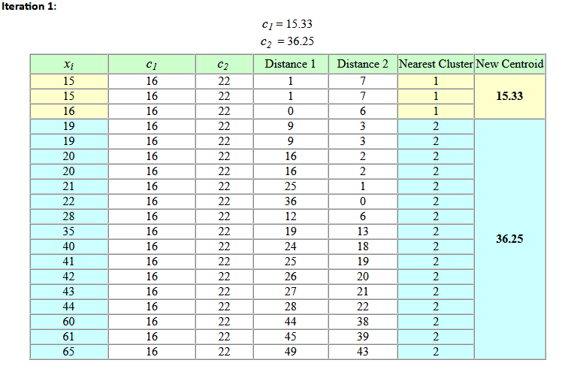
K-Means Clustering Example (Contd..)
Slide 28- <number>

Slide 31
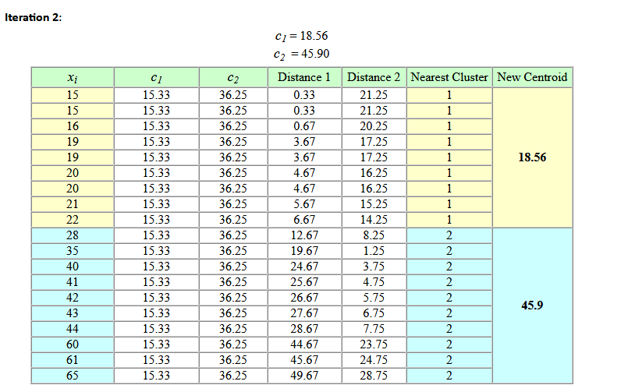
K-Means Clustering Example (Contd..)
Slide 28- <number>

Slide 32
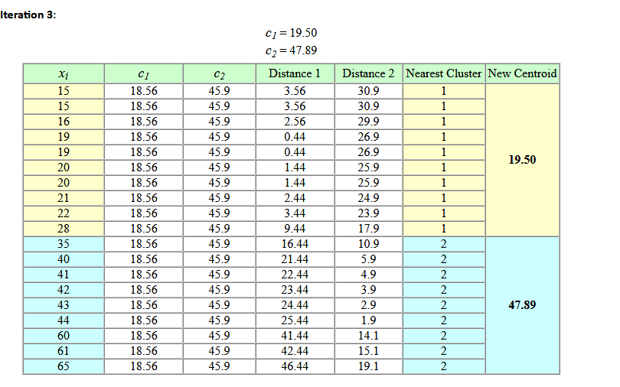
K-Means Clustering Example (Contd..)
Slide 28- <number>

Slide 33
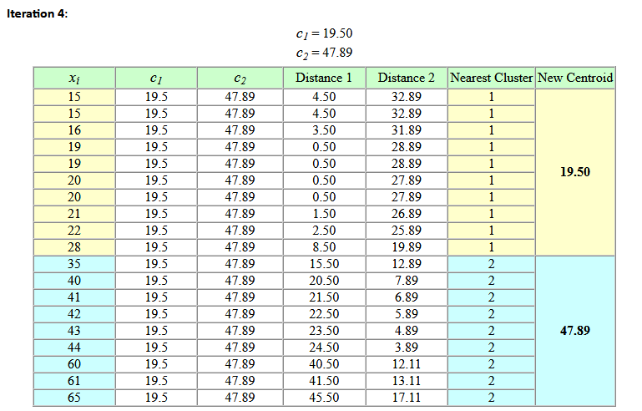
K-Means Clustering Example (Contd..)
No change between iterations 3 and 4 has been noted. By using clustering, 2 groups have been identified 15-28 and 35-65. The initial choice of centroids can affect the output clusters, so the algorithm is often run multiple times with different starting conditions in order to get a fair view of what the clusters should be.
Slide 28- <number>

Slide 34
5 Additional Approaches for Data Mining
Sequential pattern analysis
  Looks for a sequence of itemsets
  Transactions ordered by time of purchase form a sequence of itemsets.
  The support for a sequence S of itemsets is the percentage of the given set U of sequences of which S is a subsequence
  Assuming we are analyzing sequences of items as a time series for a customer, The sequence S₁, S₂, S₃, ... is a predictor of the fact that a customer who buys itemset S₁ is likely to buy itemset S₂ and then S₃, and so on.
Slide 28- <number>

Slide 35
5.4 Neural Networks
A Neural Network is a set of interconnected nodes designed to imitate the functioning of the brain.
Node connections have weights which are modified during the learning process.
Neural networks are of two types: supervised and unsupervised.
Adaptive methods that attempt to reduce the output error are supervised learning methods
Those that develop internal representations without sample outputs are called unsupervised learning methods.
The output of a supervised neural network is quantitative and not easily understood.
Unsupervised networks learn; but they do not provide a good representation of what they learn
Although neural networks suffer from above shortcomings and cannot easily deal with time series data, they are still popular.
Slide 28- <number>

Slide 36
5.5 Genetic Algorithms (1)
Genetic algorithms (GAs) are a class of randomized search procedures capable of adaptive and robust search over a wide range of search space topologies.
Modeled after the adaptive emergence of biological species from evolutionary mechanisms, Genetic learning is based on the theory of evolution.
An initial population of several candidate solutions is provided to the learning model.
A fitness function defines which solutions survive from one generation to the next.
Crossover, mutation and selection are used to create new population elements.
Slide 28- <number>

Slide 37
Genetic Algorithms (2)
The solutions produced by GAs are distinguished from most other search techniques by the following characteristics:
  A GA search uses a set of solutions during each generation rather than a single solution.
  The search in the string-space represents a much larger parallel search in the space of encoded solutions.
  The memory of the search done is represented solely by the set of solutions available for a generation.
  A genetic algorithm is a randomized algorithm since search mechanisms use probabilistic operators.
  While progressing from one generation to the next, a GA finds near-optimal balance between knowledge acquisition and exploitation by manipulating encoded solutions.
Slide 28- <number>

Slide 38
6 Data Mining / Business Analytics (B.I.) Applications
Marketing
  Marketing strategies and consumer behavior. Advertising, Service location, Customer Segmentation, Targeted mailing
Finance
  Fraud detection, creditworthiness and investment performance analysis
Manufacturing
  Resource optimization of men, machines and materials
Health
  Image analysis, genetic analysis, side effects of drug, and treatment effectiveness, process and cost optimization in healthcare services
Slide 28- <number>

Slide 39
7 Data Mining Tools
Currently, commercial data mining tools use several common techniques to extract knowledge. These include association rules, clustering, neural networks, sequencing, and statistical analysis.
Also used are decision trees, which are a representation of the rules used in classification or clustering, and statistical analyses, which may include different types of regression and many other techniques.
Some commercial products use advanced techniques such as genetic algorithms, case-based reasoning, Bayesian networks, nonlinear regression, combinatorial optimization, pattern matching, and fuzzy logic.
A set of representative tools are presented in Table 28.2
Slide 28- <number>

Slide 40
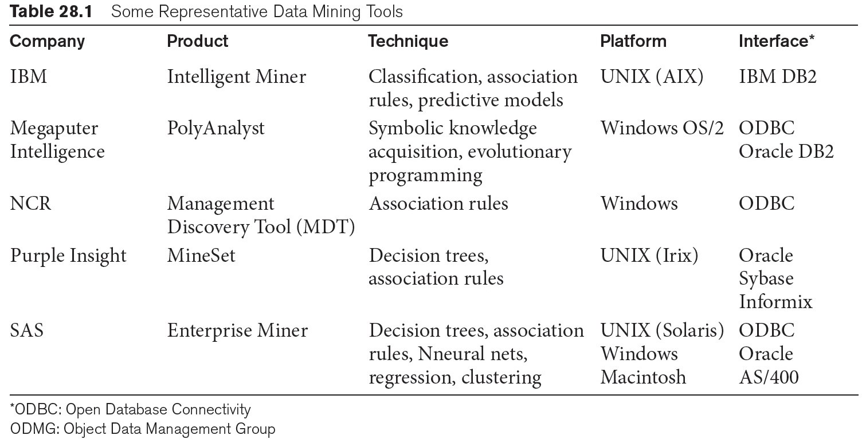
Some Commercial Data Mining Tools
Other commercial products use advanced techniques such as genetic algorithms, case-based reasoning, Bayesian networks, nonlinear regression, combinatorial optimization, pattern matching, and fuzzy logic.
Slide 28- <number>

Slide 41
Future of Data Mining
Data mining tools are continually evolving, building on ideas from the latest scientific research.
  Many of these tools incorporate the latest algorithms taken from artificial intelligence (AI), machine learning (which is a very parallel term), statistics, and optimization.
The primary direction for data mining is to analyze terabytes and petabytes of data in the so-called Big Data systems which we presented in Chapter 25.
Big Data systems are being equipped with their own tools and libraries for data mining such as Mahout which runs on top of Hadoop.
The data mining area will also be closely tied to data that will be housed in the cloud in data warehouses and brought into service for mining operations as needed using OLAP (Online Analytical Processing) servers.
Business Analytics is the primary goal of the currently advancing Spark technology.
Slide 28- <number>

Slide 42
Recap
Data Mining
Data Warehousing
Knowledge Discovery in Databases (KDD)
Goals of Data Mining and Knowledge Discovery
Association Rules
Classification
Clusering
Additional Data Mining Algorithms
  Sequential pattern analysis
  Time Series Analysis
  Regression
  Neural Networks
  Genetic Algorithms
Data Mining Applications
Commercial Data Mining Tools and Future Directions.
Slide 28- <number>

